Slide 1
Dimension Reduction of Variable Time Period Datasets of a Pneumatic System with Deep Unsupervised Learning
Master Thesis Presentation
Author: Tzu-Chen Liu
Supervisors: Univ.-Prof. Dr.-Ing. Katharina Schimitz
Faras Brumand-Poor, M.Sc. M.Sc.
Notes:
(Use laser pointer)
Thank you for the kind introduction, prof. Schmitz.
Good afternoon, everyone. My name is Tzuchen.
Today I’m going to present the work of my master’s thesis, which I did with my supervisor Faras last year.
We applied deep learning for leakage classification on simulation dataset from a pneumatic machine model.
Let’s start off with the agenda
( 0m 33s)

Slide 2
Agenda
1
Motivation
2
Problem Set-Up
3
Methodology
4
Result
5
Conclusion and Future Work
Notes:
This presentation starts with the motivation, which includes:
What is the benefit of data-based condition monitoring in fluid power systems.
What is dimension reduction and what is the benefit.
What have been done in the literature.
And the focus of this thesis.
In the other following sections, I’ll talk about:
The simulation model of the pneumatic system and the dataset
The proposed dimension reduction and leakage classification framework, and their results
Lastly, the conclusion and future work.
( 0m 32s)
( 1m 5s)

Slide 3
Motivation – Data-based Condition Monitoring with Machine Learning
Condition Monitoring
Dimension Reduction
Focus of this Thesis
Detect potential faults by monitoring one or several parameters in a machine
Early detection of failures and predictive maintenance^{[1]}
Data-based condition monitoring^{[2, 3]}
Machine learning and/or statistical approaches^{[4, 5]}
High volume of data
Unsupervised learning (UL) vs. Principal Component Analysis (PCA)^{[6]}
UL models on fluid system dataset: neural network^{[7]}, autoencoder^{[8, 9]}, variational autoencoder^{[10]}
Fixed sequence length
Dimension reduction of simulated dataset of a pneumatic machine using autoencoder (AE)
More general framework
Meaningful data representation
Apply framework on a pneumatic machine and predict leakage status (goal of condition monitoring)
Notes:
Condition monitoring is to detect potential faults by monitoring one or several parameters in a machine.
Applications can be early detection of failures and predictive maintenance.
Many fluid power systems nowadays have been equipped with a vast number of sensors to collect data, which leads to data-based condition monitoring.
Thanks to the collected data and machine learning, condition monitoring can be automated and do not always require human experts.
Although data can be helpful, high volume of data would be difficult to handle.
--( 0m 39s)
--( 1m 44s)
(click)
In cases of high volume of data, dimension reduction is necessary.
Common dimension reduction techniques are unsupervised learning and principal component analysis (PCA).
PCA is essentially a linear transformation but unsupervised learning methods such as autoencoders are capable of modelling complex non linear functions.
I researched on literature using unsupervised learning models to carry out dimension reduction task in the field of fluid systems with time-series dataset.
Models such as neural network, autoencoders, and variational autoencoder can be found in some literature, but the sequences of the time series dataset are often fixed.
--( 0m 48s)
--( 2m 32s)
(click)
Therefore, the focus of this thesis is:
First, to reduce size of a simulated dataset of a pneumatic machine using autoencoder. Autoencoder is a powerful deep unsupervised learning and also non-linear algorithm.
Second, to give a more general framework that can also take varying sequence length data
Third, to output meaningful data representation of the original dataset
Lastly, to predict leakage status with the data representation, to achieve the goal of condition monitoring
This is the motivation of this thesis.
( 2m 9s)
( 3m 14s)

Slide 4
Agenda
1
Motivation
2
Problem Set-Up
3
Methodology
4
Result
5
Conclusion and Future Work
Notes:
In the next section, I‘m going to introduce the pneumatic system, the simulation model used to create the dataset, and the dataset.
( 0m 9s)
( 3m 23s)

Slide 5
Problem Set-Up – The Pneumatic Machine
The Pneumatic Machine
System Description
mL
Mechanism:
Differential cylinder moves a variable mass horizontally
Actuated by a 5/2-way switching valve (SV)
Throttle check valve C₁, C₂ control cycle time
Static Settings
Constant pressure 6bar
Constant cylinder piston diameter 40mm
Adjustable Configurations:
Load mass (3 to 100 kg)
Velocity (150 to 450 mm/s)
Leakages (0 to 100 NL/min)
No Leakage
External Rod Leakage
External Piston Leakage
Internal Leakage
C_{ELD}
C_{L, Intern}
U
x
Y2
Q_{L}
U
C_{L, 1}
C_{L, 2}
U
P
P
Y1
C₁
C₂
SV
Notes:
On the left side is the figure of the pneumatic machine under investigation.
This is actually the same model as another student Tim Menningen’s work.
This linear pneumatic drive consists of a differential cylinder (laser pointer) that horizontally moves a variable mass (laser pointer).
The drive is actuated by a 5/2 (5 by 2) switching valve (SV) (laser pointer), supplied by a constant pressure supply of 6 bar absolute pressure.
And QL is the mass flow sensor (laser pointer).
The cylinder velocity, and thus the cycle time, is controlled by adjustable
throttle check valves C1 (laser pointer) and C2 (laser pointer)
When a test begins, the cylinder extracts and moves the load mass horizontally, and then the cylinder retracts, moving back to the beginning position and ends a test.
Different settings of the load mass, cylinder velocity and leakage types form different configurations of tests.
The leakage type is controlled by the adjustable throttles.
(ESC disable laser pointer)
( 1m 4s)
( 4m 27s)

Slide 6
Problem Set-Up – The Pneumatic Machine
The Pneumatic Machine
System Description
mL
Mechanism:
Differential cylinder moves a variable mass horizontally
Actuated by a 5/2-way switching valve (SV)
Throttle check valve C₁, C₂ control cycle time
Static Settings
Constant pressure 6bar
Constant cylinder piston diameter 40mm
Adjustable Configurations:
Load mass (3 to 100 kg)
Velocity (150 to 450 mm/s)
Leakages (0 to 100 NL/min)
No Leakage
External Rod Leakage
External Piston Leakage
Internal Leakage
C_{ELD}
C_{L, Intern}
U
x
Y2
Internal Leakage
Q_{L}
U
C_{L, 1}
C_{L, 2}
U
P
P
Y1
C₁
C₂
External Rod Leakage
External Piston Leakage
SV
Notes:
The adjustable throttles CL1 simulates external leakage at the rod’s side (click), and CL2 simulates external leakage at the piston’s side (click), and CL intern the internal leakage.
Each test either has no leakage or only contains one leakage type.
( 0m 20s)
( 4m 47s)

Slide 7
Problem Set-Up – Simulation Dataset Description
The Pneumatic Machine
Simulation Dataset Description
mL
10 cycles of extraction and retraction for every configuration
Dataset of this thesis includes simulated data of:
Valve status
Cylinder displacement
Cylinder velocity (calculated by Δ_{displacement} / Δ_{time})
C_{ELD}
C_{L, Intern}
U
x
Y2
Q_{L}
U
C_{L, 1}
C_{L, 2}
U
P
P
Y1
C₁
C₂
SV
Notes:
The simulation dataset is kindly provided by Tim Menningen and Raphael Alt
To obtain dataset by simulation, for each configuration of load mass, cylinder velocity and leakage type, 10 cycles of extraction and retraction are simulated.
The valve status and the displacement of the cylinder are directly recorded as time-series data, and 1 cycle of extraction and retraction is one data sequence.
The sampling period is 1 millisecond, and the velocity can be calculated as the derivative of the displacement.
( 0m 38s)
( 5m 25s)

Slide 8
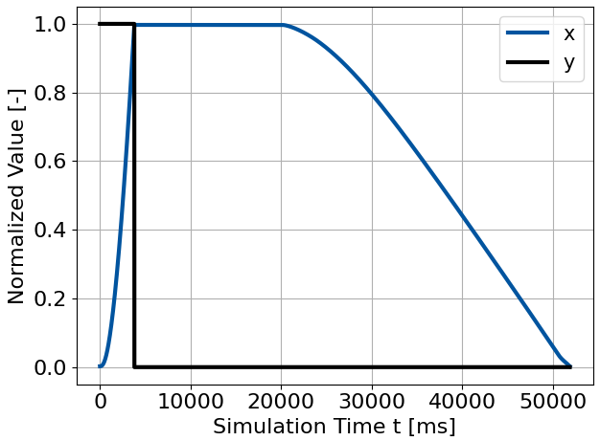
Problem Set-Up – Example of a Sequence
The Pneumatic Machine
Example of a Sequence
mL
x: Normalized Cylinder Displacement
y: Normalized Valve Status
C_{ELD}
C_{L, Intern}
U
x
Y2
Q_{L}
U
C_{L, 1}
C_{L, 2}
U
P
P
Y1
C₁
C₂
y
Notes:
The figure on the right is an example of one data sequence
The blue line is the normalized cylinder displacement, and the black line the normalized valve status.
With the increase of simulation time steps, the displacement of cylinder increases until the maximum value and then decreases to the beginning value.
( 0m 22s)
( 5m 47s)

Slide 9
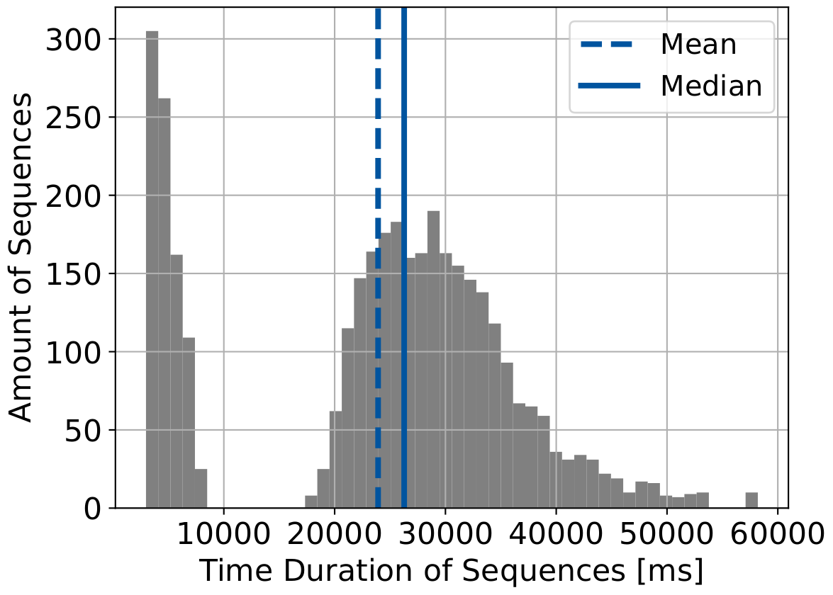
Problem Set-Up – Histogram of Sequence Length
The Pneumatic Machine
Histogram of Sequence Length
mL
C_{ELD}
C_{L, Intern}
U
x
Y2
Q_{L}
U
C_{L, 1}
C_{L, 2}
U
P
P
Y1
C₁
C₂
SV
Notes:
The figure on the right is the histogram of sequence lengths of all sequences.
The X axis is the length, the Y axis is the amount of sequences of a specific length range.
Machine learning models require the input sequences to be of the same length.
If the length does not vary too much, maybe sequences can be adjusted to the same length by up-sampling, down-sampling, or padding methods.
But the dataset for this thesis contain highly varying sequence lengths and is therefore problematic.
We have to solve this problem, and the proposed method will be shown in the next section, Methodology.
( 0m 41s)
( 6m 28s)

Slide 10
Agenda
1
Motivation
2
Problem Set-Up
3
Methodology
4
Result
5
Conclusion and Future Work
Notes:
In this section, I will first show how general machine learning models are trained
, and the reason why I cannot train my models on this dataset using the general framework
, and then explain how are my models are trained instead.
( 0m 16s)
( 6m 44s)

Slide 11
Methodology – Standard Pipeline of Training Machine Learning Models
Model
Training Data
Mini-Batches
Train Model with Mini-Batches
All Sequences
Evaluate Trained Model with Testing Data
Testing Data
Notes:
This diagram shows the common pipeline of training machine learning models with time-series dataset. Each rectangle represents a data sequence.
The dataset would be separated into two parts: training and testing data.
(click) The sequences in the training data would be further grouped into mini-batches.
After the model is trained, the testing dataset is used to evaluate the performance of the model.
(click)
And the mini-batches of sequences are used to train the model.
(click)
However, problems would happen here when sequence lengths vary
( 0m 38s)
( 7m 22s)

Slide 12
Methodology – Problem with Variable Sequence Length
Model
Training Data
Size of Model’s input is required to be fixed
Mini-Batches
All Sequences
Evaluate Trained Model with Testing Data
Testing Data
Notes:
Machine learning models require each data sequence to be the same size.
But this dataset in this thesis does not satisfy this requirement.
( 0m 11s)
( 7m 33s)

Slide 13
Methodology – Slice Sequences with Different Lengths to Fixed Size Windows
Beginning of the sequence
End of the sequence
One Data Sequence
Window
Window
Window Overlap
Window
Window
Fixed Window Length
Notes:
In order to solve this problem, each data sequence is first sliced into windows with a fixed length. Which means, a long data sequence is sliced into more windows than a short data sequence.
( 0m 13s)
( 7m 46s)

Slide 14
Methodology – Use All Windows as Input Instead of All Sequences
Dimension Reduction
Model
Training Data
Train Model with Mini-Batches
All Windows
Evaluate Trained Model with Testing Data
Testing Data
Notes:
Afterward, the input data “all sequences” is now replaced by “all windows” (click), and the light blue rectangle here represent windows instead of sequences. Because the size of windows is fixed, this pipeline can now work.
(click)
Now let’s go into more detail of the model to see how it learns.
( 0m 22s)
( 8m 8s)

Slide 15
Methodology – Structure of Autoencoder
Autoencoder
One mini-batch of input windows
Encoder
Latent Space
Decoder
Reconstructed Windows
Notes:
The autoencoder model consist of encoder, latent space, and decoder.
The encoder takes one mini-batch of windows as input, and the encoder compress the input data into a much smaller latent space.
One window results in only one latent data point with pre-defined number of dimensions.
The number of dimension of latent space is a pre-defined number, not related to the number of dimension of the window.
The job of the decoder is to decode the latent space to reconstruct the input windows.
The goal of the model is that the reconstructed windows should be the same as the input windows.
( 0m 43s)
( 8m 51s)

Slide 16
Methodology – Loss of Autoencoder
Autoencoder
One mini-batch of input windows
Encoder
Latent Space
Decoder
Reconstructed Windows
Loss = mean square error between input and reconstructed data
Loss is used to update the parameters inside the autoencoder model
Notes:
In the beginning, the reconstructed windows are very different from the input windows.
And then the encoder and decoder update values of their parameters according to the loss.
The loss is the mean square error between input and reconstructed data.
The intuitive meaning of the loss is: how different are the original and the reconstructed windows.
The technical term of this model updating step is called “back-propagation”.
The intuitive idea is to learn from the mistake it made in the past.
The larger the mistake is, the more the encoder and decoder should be adjusted.
After iterations of this learning process, the reconstructed windows will be almost the same as the input windows.
( 0m 47s)
( 9m 38s)

Slide 17
Methodology – Loss of Autoencoder
Autoencoder
Encoder
Latent Space
Decoder
The reduced data.
The data representation.
Notes:
After training the model with all the windows, the latent space can be viewed as the reduced data or the data representation of the original input data.
( 0m 11s)
( 9m 49s)

Slide 18
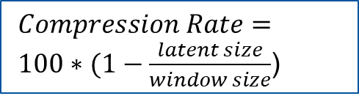
Methodology – The 12 Autoencoder Models
Linear_F2_L2
$Compression Rate= 100∗(1−\frac{latent size}{window size}$)
Layer Type
Feature Size
Latent Size
Model | Compression Rate [%]
F2_L2 | 99.5
F2_L4 | 99
F2_L64 | 84
F3_L3 | 99.5
F3_L4 | 99.3
F3_L64 | 89.3
Linear
LSTM
F2: Valve status
Cylinder displacement
F3:
Add Cylinder velocity
Same as F ^{[11]}
L64 ^{[9]}
L4
Notes:
In this thesis, autoencoder models with different settings were implemented.
In order to describe every model easily, I implemented a naming system, and the Linear_F2_L2 here is an example.
The different settings of models are in 3 aspects: Layer type, feature size, and latent size.
For layer type, there are two different settings:
The model contain only linear layers, or the model contains also LSTM layer.
LSTM is a special kind of neural network which remembers things from the past, and is therefore commonly used for time-series data.
On the other hand, for linear layers it doesn’t matter what happened before.
There are two different feature size options, namely 2 or 3 features.
F2 means the dataset contain only two features, which are the valve status and the cylinder displacement.
F3 means the dataset contains 3 features, which are valve status, cylinder displacement, and cylinder velocity.
--( 1m 8s)
--( 10m 57s)
And there are three different latent size settings.
The latent size defines the size of the data representation, and is a parameter that can be tuned.
The smaller the latent size is, the smaller the data representation size is.
Latent size is a hyper parameter which needs to be tuned
Here I chose 3 different settings to research on.
The first two options are inspired by the literature.
The “Same as F” means L2 for 2 feature models or L3 for 3 features model.
The idea for the third option, L4, is: since we have 4 leakage types, maybe the model can make one latent correspond to one leakage type
(click)
The compression rate can be calculated by the latent size.
The smaller the latent size is, the higher the compression rate is.
The compression rates of the autoencoder models investigated in this thesis are listed.
The highest compression rate is 99.5%, and the lowest is 84%.
Until now is the methodology of the dimension reduction part. The following slides are the methodology of the classification part.
( 2m 23s)
( 12m 12s)

Slide 19
Methodology - Train Classification Model Using the Latent Space
Train
Classification
Model
4 Leakage
Categories
Input Windows
Encoder
Latent Space
Decoder
Reconstructed Windows
Notes:
Because the latent space can be viewed as the representation of the input, this thesis train the leakage classification model on the latent space instead of the original dataset.
The goal of the classification model is to recognize 4 different leakage categories: no leakage, external rod leakage, external piston leakage, and internal leakage.
( 0m 23s)
( 12m 35s)

Slide 20
Methodology - Training Pipeline of a Classification Model
Classification
Model
Leakage Category
Latent
Space
Mean of
Latent Space
Classification algorithms used: Random Forest (RF)
Multi-Layer Perceptron (MLP)
Windows of a Sequence
Encoder
Notes:
The general pipeline of training classification models is similar to the previously mentioned pipeline.
However, because of the varying sequence length and the fixed window size, the number of windows sliced from each sequence can be different, and the size of the resulting latent space can therefore also be different.
And again, the classification model can only take input with a fixed size.
To solve this problem, for each sequence, the mean of all latent data points resulted from all windows of this sequence is taken.
Therefore, each data sequence is only represented by one data point, and the size of this data point equals to the number of dimensions of the latent space.
The two classification algorithms used in this thesis are random forest and multi-layer perceptron. These are widely used algorithms on classification applications.
( 0m 55s)
( 13m 30s)

Slide 21
Methodology – Random Forest and Multi-Layer Perceptron
Random Forest
Multi-Layer Perceptron
Input
Input
Decision Tree
Decision Tree
Decision Tree
Hidden
Layer
No Leakage
No Leakage
Internal Leakage
Output
Layer
No Leakage
No Leakage
External Rod Leakage
External Piston Leakage
Internal Leakage
Notes:
Random forest algorithm consists of decision trees, and the classification result depends on the majority vote.
The intuitive idea is the one that most of the decision trees agree on.
Multi-layer perceptron, as its name suggests, contains layers of perceptrons.
The input data come to the hidden layer. There can be one or multiple hidden layers.
After the hidden layers, the information flow to the output layer.
In this thesis there are 4 different leakage classes, so the output layer contains 4 perceptrons.
Each perceptron outputs one value, and the class with the greatest value is the output of this multi-layer perceptron classifier.
The details of the decision tree and the perceptron are not the focus of the thesis, so I put the information about them in the appendix.
We can talk more about them in the Q & A section if anyone is interested.
( 0m 58s)
( 14m 28s)

Slide 22
Agenda
1
Motivation
2
Problem Set-Up
3
Methodology
4
Result
5
Conclusion and Future Work
Notes:
In this section, I will present the result of the unsupervised dimension reduction models as well as the leakage classification models.
( 0m 9s)
( 14m 37s)

Slide 23
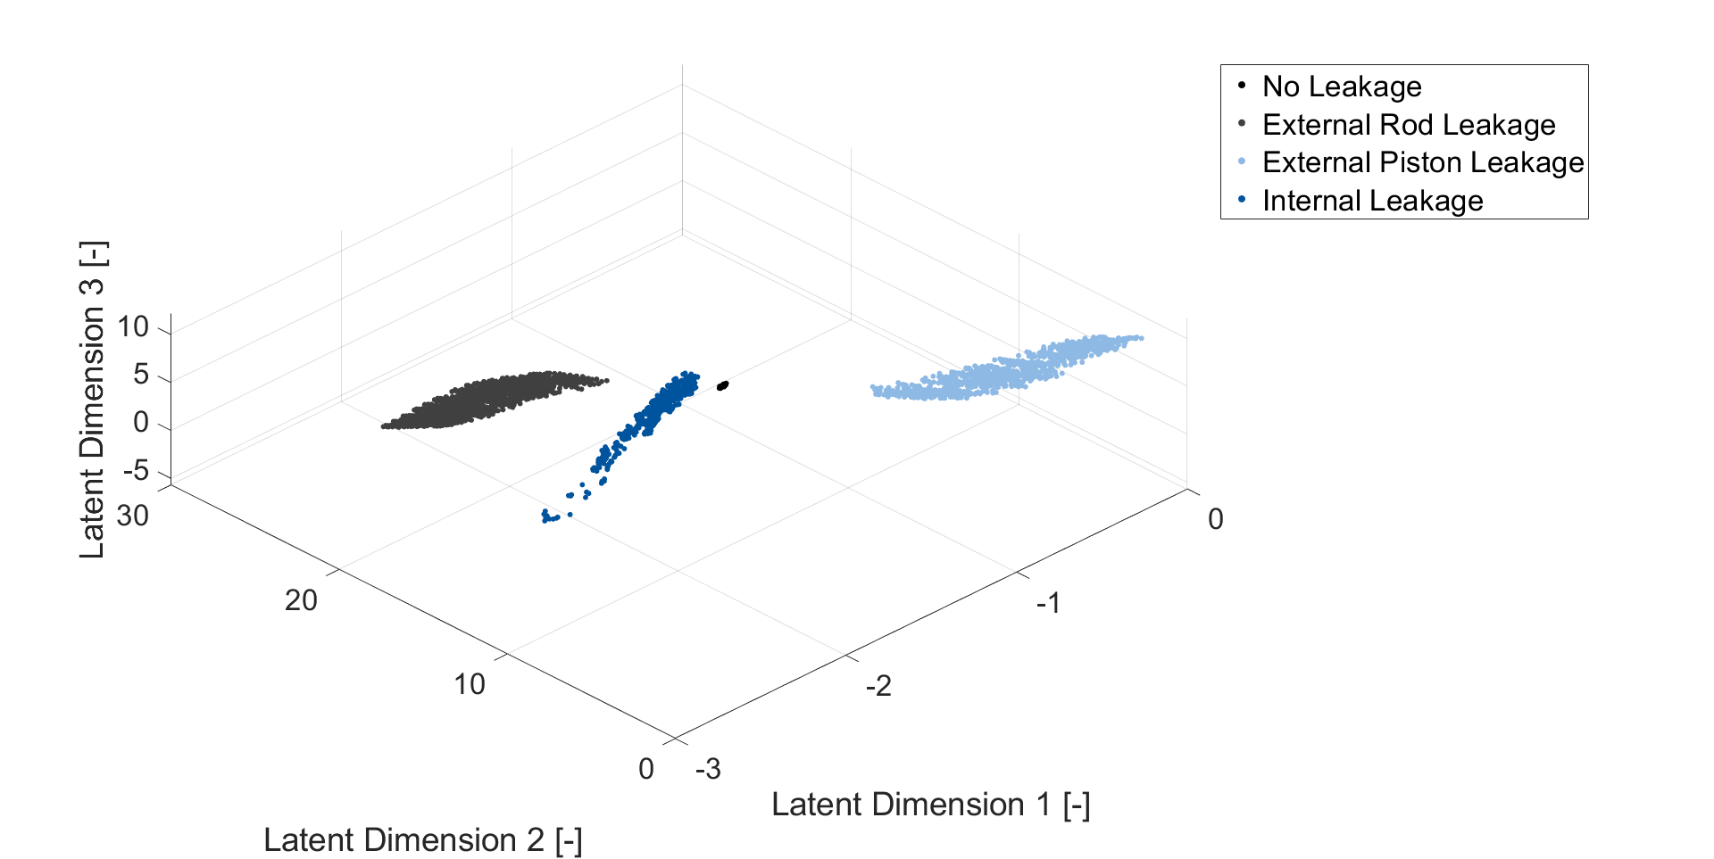
Result – Latent Space of Linear_F3_L3
Each data point represent the mean of latent values of a sequence
Notes:
This slide shows the latent space.
These are not yet the classification result but the ground truth for training classification models. The classification results will be shown later.
This figure is the latent space generated by a model with linear layers, 3 features, and 3 dimensional latent space.
Each data point represent the mean of latent data points of a sequence.
For example, if a data sequence with no leakage comes, it is first sliced into windows, and each window results in one latent data point, and then the mean of these data points has 3 values because the latent space is defined as 3 dimensional in this autoencoder model.
The 3 values of the mean are plotted in this figure as a black dot.
In this figure, the boundary between the 4 leakage category is clear, meaning the autoencoder model is capable of separating the latent data points into different regions.
( 1m 2s)
( 15m 39s)

Slide 24
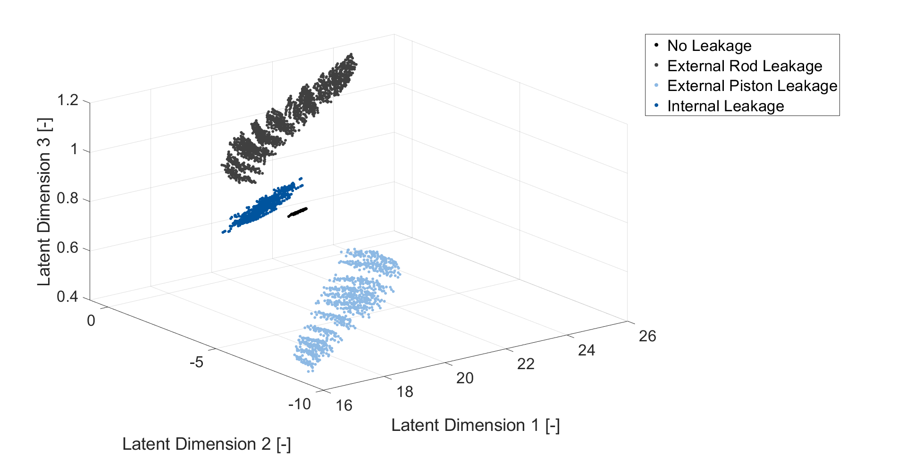
Result – Latent Space of LSTM_F3_L3
Each data point represent the mean of latent values of a sequence
Notes:
This figure is the latent space generated by a model with LSTM layers, 3 features, and 3 dimensional latent space.
The setting of feature and latent space dimension are the same as the previous slide, only it contains LSTM layer.
( 0m 15s)
( 15m 54s)

Slide 25
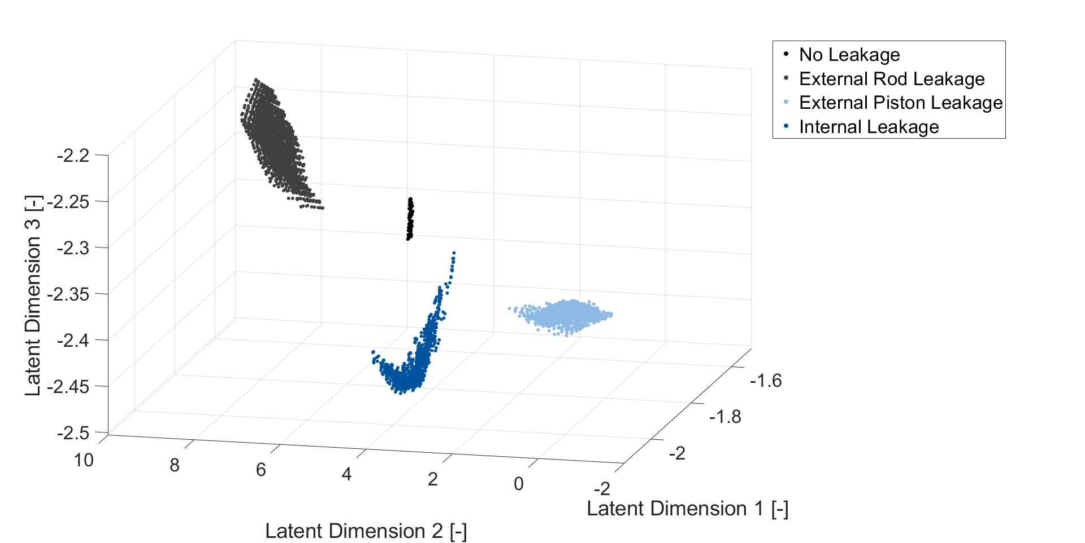
Result – Latent Space of LSTM_F3_L4
Each data point represent the mean of latent values of a sequence
Notes:
This figure is the latent space generated by a model with LSTM layers, 3 features, and 4 dimensional latent space.
The setting of model type and feature are the same as the previous slide, only the latent dimension is higher.
( 0m 16s)
( 16m 10s)

Slide 26
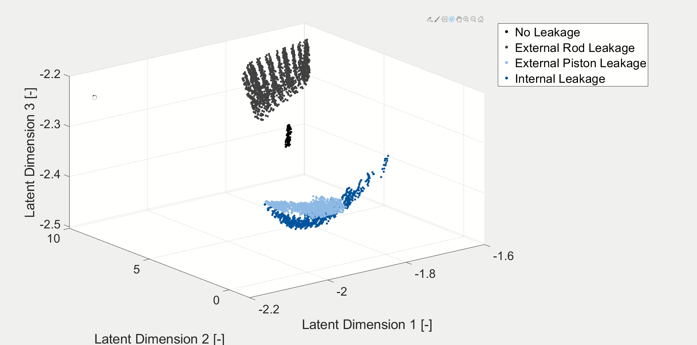
Result – Latent Space of LSTM_F3_L4
Notes:
In order to demonstrate the 3 dimensional plot more clearly, here I prepared a short video of it.
The 4 different leakage categories are clearly separable from one another.
( 0m 18s)
( 16m 28s)

Slide 27
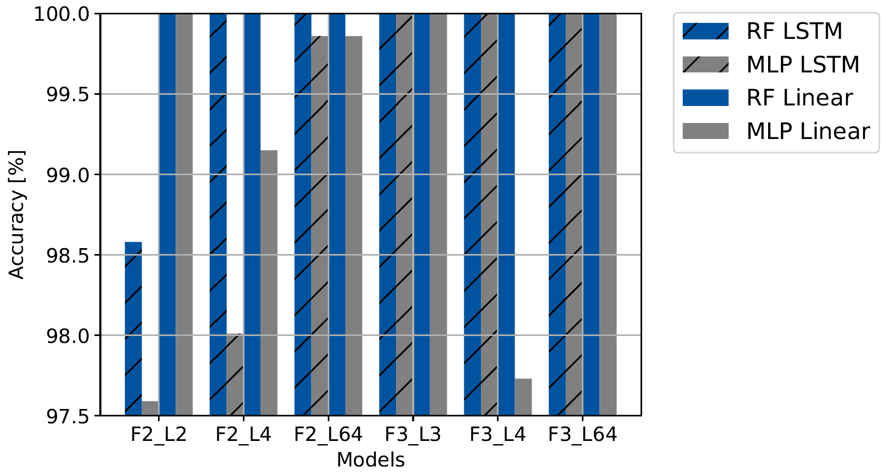
Result – Leakage Classification Accuracy
RF: Random Forest
MLP: Multi-Layer Perceptron
Notes:
Now we have the latent, and with this latent we implemented leakage status classifiers, which should tell the leakage status of the system:
It’s no leakage, external rod leakage, external piston leakage, or internal leakage.
Generally speaking, all of classifiers perform well.
In this study, random forest algorithm performs a little bit better than multi-layer perceptron, and the models with larger latent size also perform a little bit better.
Still, all of them perform very well in classifying leakage types.
All the classification results are higher than 97%, some are even 100%, so the differences between classifiers are not much.
One reason is that, the latent data are already very well separated, as shown in previous latent space figures.
Most importantly, the data used in this thesis is simulated without noise and disturbance.
By adding noise and disturbance, or if real data collected from machines are used, the accuracies are likely to drop.
( 1m 10s)
( 17m 38s)

Slide 28
Agenda
1
Motivation
2
Problem Set-Up
3
Methodology
4
Result
5
Conclusion and Future Work
Notes:
The last section of my presentation is conclusion and future work.
( 0m 5s)
( 17m 43s)

Slide 29
Conclusion and Future Work
Conclusion
Future Work
Data from a pneumatic machine can be reduced to small data representation but still contain enough information for reconstruction and classification
The unsupervised learning models can create separate spaces for every leakage.
Classification performing with high accuracy
This framework can take time-series dataset with varying sequence length as input
Add noise and disturbance to the simulation model
Take experimental data as input instead of simulated data.
Apply the training framework to other machines.
Variational Autoencoder (VAE) is able to create artificial data, which can be investigated.
Notes:
This thesis reduces the simulation data of a pneumatic machine by at least 84%, and the reduced, much smaller data representation, still contains enough information for reconstruction task and classification task.
The autoencoder models not only compress the data into smaller data representation, but also make separate regions in the latent space for different leakage categories.
The classification models built on the latent space can predict the leakage category with high accuracy.
In addition, because the models are trained by windows with fixed size instead of sequences, the whole framework proposed by this thesis is more general and can also apply to time-series dataset with varying sequence length.
Overall, this thesis applies deep learning techniques on fluid power systems for condition monitoring, and the connection of the unsupervised learning data compression algorithm and the supervised learning classification models forms a useful framework for further research
--( 1m 10s)
--( 18m 53s)
(click)
For future work, the data used in this thesis come from a simulation without noise and disturbance.
So the future work can be taking noise and disturbance into the simulation dataset, or to further use experimental data as input.
Another research direction can be applying this training framework to the dataset of other machines.
In addition, to improve in a machine learning way, the enhancement of autoencoder, which is the variational autoencoder, can be investigated.
Variational autoencoder focus even more on the latent space, so it's possible to investigate the reduced data representation even more.
( 1m 51s)
( 19m 34s)

Slide 30
[1]: N. Helwig, E. Pignanelli, and A. Sch¨utze, “Condition monitoring of a complex hydraulic system using multivariate statistics,” in 2015 IEEE International Instrumentation and Measurement Technology Conference (I2MTC) Proceedings, 2015, pp. 210–215.
[2]: F. Makansi and K. Schmitz, “Simulation-based data sampling for condition monitoring of fluid power drives,” IOP Conference Series: Materials Science and Engineering, vol. 1097, 2021.
[3]: M. Karpenko and N. Sepehri, “Neural network classifiers applied to condition monitoring of a pneumatic process valve actuator,” Engineering Applications of Artificial Intelligence, vol. 15, pp. 273–283, 06 2002.
[4]: T. Kovacs and A. Ko, “Monitoring pneumatic actuators’ behavior using real-world data set,” SN Computer Science, vol. 1, 06 2020.
[5]: M. Demetgul, I. Tansel, and S. Taskin, “Fault diagnosis of pneumatic systems with artificial neural network algorithms,” Expert Systems with Applications, vol. 36, no. 7, pp. 10 512–10 519, 2009. https://www.sciencedirect.com/science/article/pii/S0957417409000657
[6]: L. Siyuan, D. Linlin, and J. Wanlu, “Study on application of principal component analysis to fault detection in hydraulic pump,” 08 2011.
[7]: Y. Lei, F. Jia, J. Lin, S. Xing, and S. Ding, “An intelligent fault diagnosis method using unsupervised feature learning towards mechanical big data,” IEEE Transactions on Industrial Electronics, vol. 63, pp. 1–1, 05 2016.
[8]: Z. Huijie, R. Ting, W. Xinqing, Z. L. You, and F. Husheng, “Fault diagnosis of hydraulic pump based on stacked autoencoders,” 2015 12th IEEE International Conference on Electronic Measurement & Instruments (ICEMI), vol. 01, pp. 58–62, 2015.
[9]: A. Mallak and M. Fathi, “Sensor and component fault detection and diagnosis for hydraulic machinery integrating lstm autoencoder detector and diagnostic classifiers,” Sensors, vol. 21, no. 2, 2021. https://www.mdpi.com/1424-8220/21/2/433
[10]: J. Hennig, A. Umakantha, and R.Williamson, “Sequence generation and classification with vaes and rnns,” in Proceedings of the 34 th International Conference on Machine Learning. Sydney, Australia: JMLR: WCP, 2017.
[11]: J. D. Co-Reyes, Y. Liu, A. Gupta, B. Eysenbach, P. Abbeel, and S. Levine, “Self-consistent trajectory autoencoder: Hierarchical reinforcement learning with trajectory embeddings,” 2018.
Notes:
Q&A:
Q: Can it be applied to other machine?
A: Yes, Generally the pipeline can be applied to other machines, but the parameters may need some tunings.
Q: Difference between Linear and LSTM
A: LSTM performs better but not super much better. The reason can be because the dataset is not very complicated, so the linear models are also able to learn the pattern.
Q: Why didn’t add noise and disturbance to the simulation model
A: This thesis was actually finished last November. The presentation is today because there were no available presentation timeslots last December and this January. When Tim told me about the available newer simulation dataset, my research was already finished so I couldn’t managed to use the better simulation dataset. This is why I put this in the future work section.

Slide 31
Appendix – All 12 Autoencoder Models
Model Name | Recurrent Neural Network (LSTM) | Feature Size (F) | Latent Dimension (L)
Linear_F2_L2 | No | 2 | 2
Linear_F2_L4 | No | 2 | 4
Linear_F2_L64 | No | 2 | 64
Linear_F3_L3 | No | 3 | 3
Linear_F3_L4 | No | 3 | 4
Linear_F3_L64 | No | 3 | 64
LSTM_F2_L2 | Yes | 2 | 2
LSTM_F2_L4 | Yes | 2 | 4
LSTM_F2_L64 | Yes | 2 | 64
LSTM_F3_L3 | Yes | 3 | 3
LSTM_F3_L4 | Yes | 3 | 4
LSTM_F3_L64 | Yes | 3 | 64
2 Features:
Displacement and valve
3 Features:
Displacement, valve
and velocity
Notes:
(1m)
In this thesis, 12 autoencoder models with different settings were implemented.
First, we take a look at the the column recurrent neural network.
Recurrent neural network is a kind of neural network which remembers things from the past. It is therefore commonly used for time-series data. LSTM is one kind of the recurrent neural network.
The “Yes” here means this model contains one LSTM layer in both encoder and decoder, and the “No” means this model doesn’t contain any LSTM layer.
Feature size. Feature size 2 means this model is trained only by the cylinder displacement data and the valve status data.
Feature size 3 means the dataset also contains velocity, which is calculated by the derivative of displacement.
Feature dimension. Latent dimension value is the same as the feature size, or 4, or 64.

Slide 32
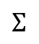
Appendix – Decision Tree and Perceptron
Decision Tree
Perceptron
Input
Inputs
Weights
X₁
Class A
Condition
A
W₁
Yes
X₂
W₂
No
Activation
Function
Condition
B
$$Σ$$
Output
Class B
Yes
No
Class C
X_{N}
W_{N}
Bias

Slide 33
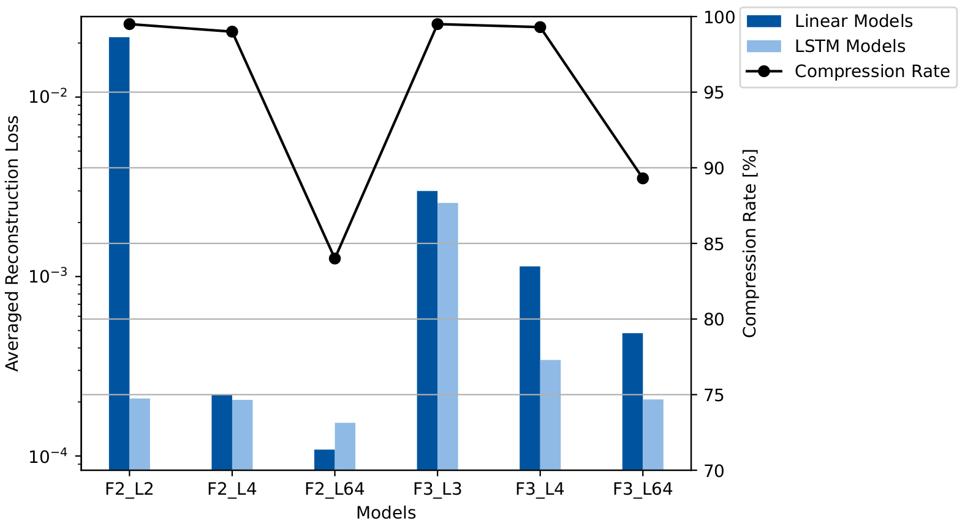
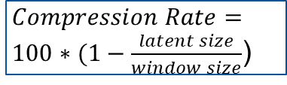
Appendix – Reconstruction Loss Comparison
$Compression Rate= 100∗(1−\frac{latent size}{window size}$)
Notes:
(1m)
This figure shows the reconstruction error as well as the compression rate of each model.
The compression rate is a percentage calculated by 1 minus the ratio of latent size divided by the window size.
When the latent size is smaller, the compression rate is higher, meaning the input data is compressed to a smaller data representation.
However, the reconstruction error decreases with the increase of latent size.
This means, when the latent size is larger, the original data can be better represented.
In addition, the reconstruction loss of models with LSTM layer is lower, and increasing the feature size by adding velocity data does not help to reduce the reconstruction error.

Slide 34
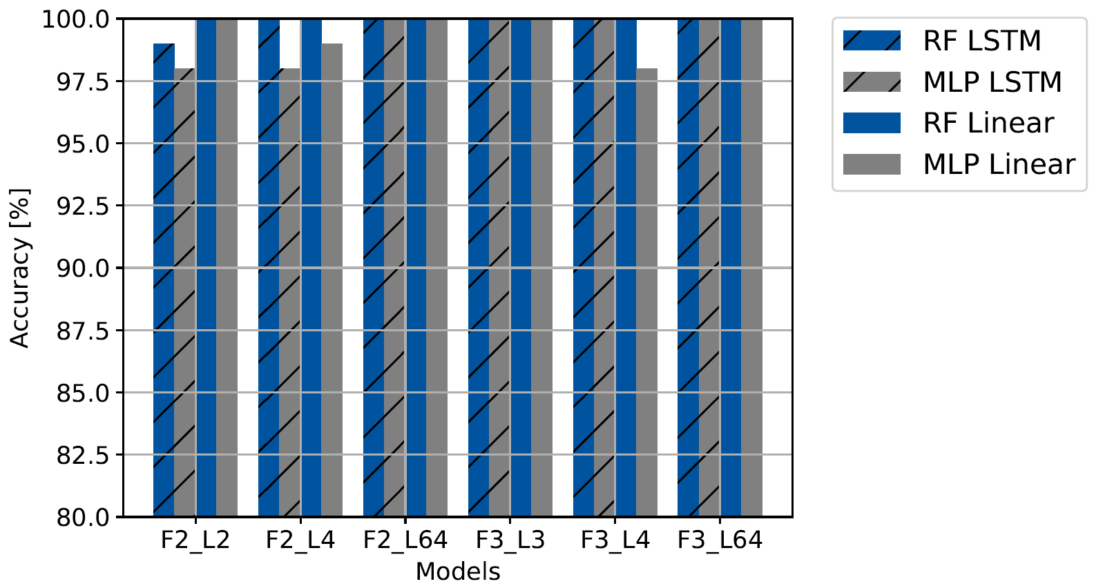
Result - Classification Accuracy
RF: random forest
MLP: multi-layer perceptron
LSTM: has recurrent neural
network layer
Notes:
(1m)
The latent space are then used to train the classification models and this slide shows the result.
In this thesis, two classification models are implemented: the random forest and the multi-layer perceptron.
The right most gray bar is the accuracy of a multi-layer perceptron model, which is trained by the latent space generated by autoencoder with 3 features, 64 dimensional latent, and without LSTM layer.
All the classification results are very close to 100%, because the latent data are already very well separated.

Slide 35
[1]: N. Helwig, E. Pignanelli, and A. Sch¨utze, “Condition monitoring of a complex hydraulic system using multivariate statistics,” in 2015 IEEE International Instrumentation and Measurement Technology Conference (I2MTC) Proceedings, 2015, pp. 210–215.
[2]: F. Makansi and K. Schmitz, “Simulation-based data sampling for condition monitoring of fluid power drives,” IOP Conference Series: Materials Science and Engineering, vol. 1097, 2021.
[3]: M. Karpenko and N. Sepehri, “Neural network classifiers applied to condition monitoring of a pneumatic process valve actuator,” Engineering Applications of Artificial Intelligence, vol. 15, pp. 273–283, 06 2002.
[4]: T. Kovacs and A. Ko, “Monitoring pneumatic actuators’ behavior using real-world data set,” SN Computer Science, vol. 1, 06 2020.
[5]: M. Demetgul, I. Tansel, and S. Taskin, “Fault diagnosis of pneumatic systems with artificial neural network algorithms,” Expert Systems with Applications, vol. 36, no. 7, pp. 10 512–10 519, 2009. https://www.sciencedirect.com/science/article/pii/S0957417409000657
[6]: L. Siyuan, D. Linlin, and J. Wanlu, “Study on application of principal component analysis to fault detection in hydraulic pump,” 08 2011.
[7]: Y. Lei, F. Jia, J. Lin, S. Xing, and S. Ding, “An intelligent fault diagnosis method using unsupervised feature learning towards mechanical big data,” IEEE Transactions on Industrial Electronics, vol. 63, pp. 1–1, 05 2016.
[8]: Z. Huijie, R. Ting, W. Xinqing, Z. L. You, and F. Husheng, “Fault diagnosis of hydraulic pump based on stacked autoencoders,” 2015 12th IEEE International Conference on Electronic Measurement & Instruments (ICEMI), vol. 01, pp. 58–62, 2015.
[9]: A. Mallak and M. Fathi, “Sensor and component fault detection and diagnosis for hydraulic machinery integrating lstm autoencoder detector and diagnostic classifiers,” Sensors, vol. 21, no. 2, 2021. https://www.mdpi.com/1424-8220/21/2/433
[10]: J. Hennig, A. Umakantha, and R.Williamson, “Sequence generation and classification with vaes and rnns,” in Proceedings of the 34 th International Conference on Machine Learning. Sydney, Australia: JMLR: WCP, 2017.
[11]: J. D. Co-Reyes, Y. Liu, A. Gupta, B. Eysenbach, P. Abbeel, and S. Levine, “Self-consistent trajectory autoencoder: Hierarchical reinforcement learning with trajectory embeddings,” 2018.
Notes:
Q&A:
Q: Can it be applied to other machine?
A: Yes, Generally the pipeline can be applied to other machines, but the parameters may need some tunings.
Q: Difference between Linear and LSTM
A: LSTM performs better but not super much better. The reason can be because the dataset is not very complicated, so the linear models are also able to learn the pattern.
Q: Why didn’t add noise and disturbance to the simulation model
A: This thesis was actually finished last November. The presentation is today because there were no available presentation timeslots last December and this January. When Tim told me about the available newer simulation dataset, my research was already finished so I couldn’t managed to use the better simulation dataset. This is why I put this in the future work section.
Q: When use noise, accuracy may decrease, how can the model adjust to this?
A: The autoencoder architecture (add more neural network layers), latent size, window size

Slide 36
Result
The latent space
generated by
autoencoder model
Linear_F2_L2
Each data point
represent the
mean of
latent values
of a sequence
Notes:
From this slide on, 8 figures of latent spaces are shown.
These are not yet the classification result but the ground truth.
These ground truth are used to train the classification models, and the classification results will be shown after these 8 slides.
This figure is the latent space generated by model Linear_F2_L2.
Each data point represent the mean of latent data points of a sequence.
For example, if a data sequence with no leakage comes, it is first sliced into windows, and each window results in one latent data point, and then the mean of these data points has 2 values because the latent space is defined as 2 dimensional in this autoencoder model.
The 2 values of the mean are plotted in this figure as a light blue dot.
In this figure, the boundary between no leakage, the light blue dot, and internal leakage, the black dot, is ambiguous.
The latent dimension of this model is only 2, and this model cannot separate sequences with different leakage status.

Slide 37
Result
The latent space
generated by
autoencoder model
LSTM_F2_L2
Each data point
represent the
mean of
latent values
of a sequence
Notes:
This is the latent space generated by model LSTM_F2_L2.
The latent dimension of this model is also only 2, and the boundary between no leakage and internal leakage is also ambiguous.

Slide 38
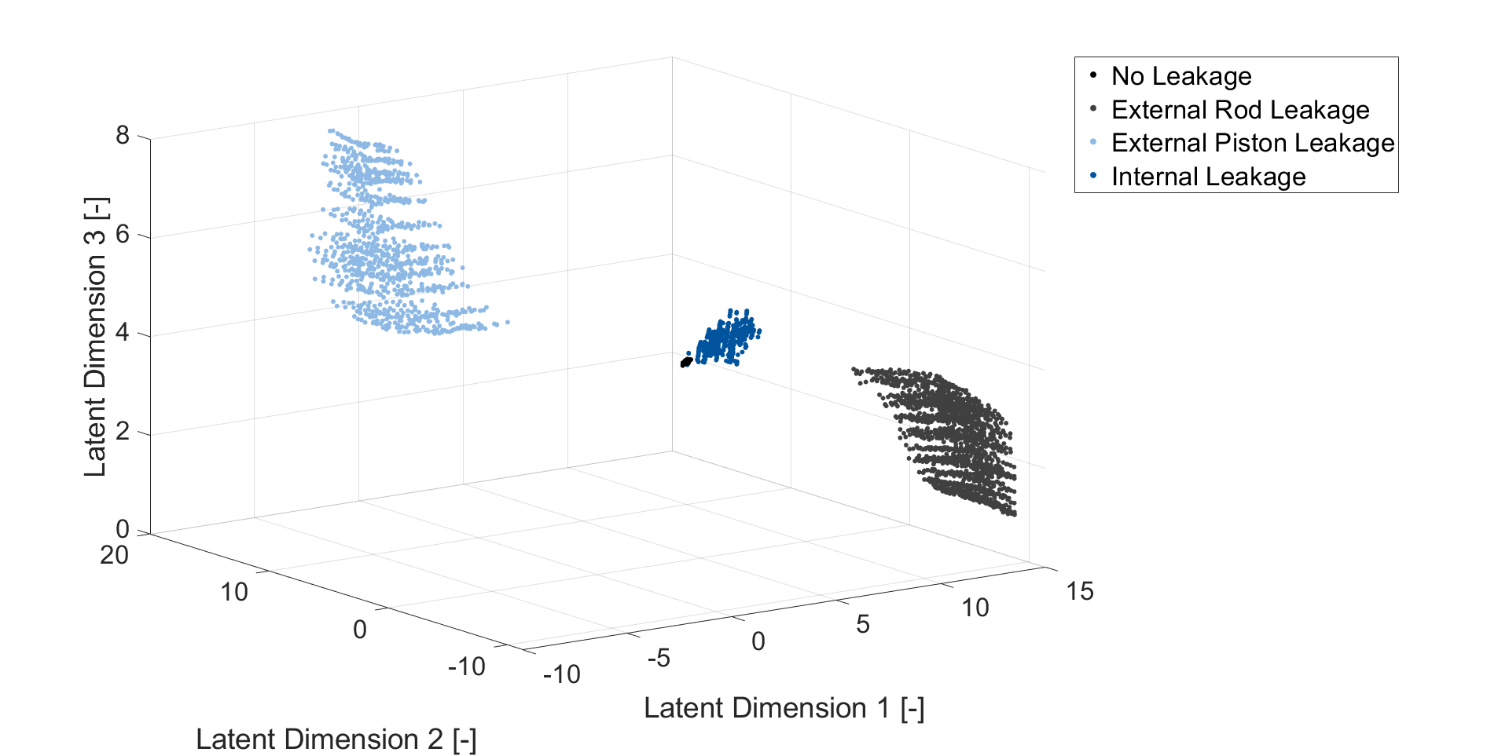
Result
The latent space
generated by
autoencoder model
Linear_F2_L4
Each data point
represent the
mean of
latent values
of a sequence
Notes:
This is the latent space generated by model Linear_F2_L4.
The latent space has 4 dimension, but the 3 dimension with greater variances are chosen for plotting this figure.
With the setting of 2 features and 4 dimensional latent, the data points representing no leakage and internal leakage are more separable, but the boundary is still not clear.

Slide 39
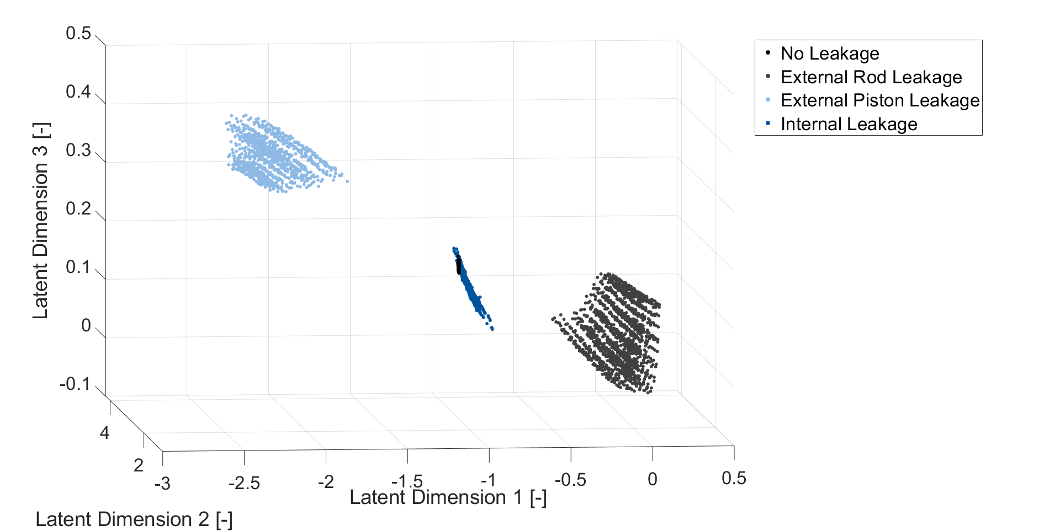
Result
The latent space
generated by
autoencoder model
LSTM_F2_L4
Each data point
represent the
mean of
latent values
of a sequence
Notes:
This is the latent space generated by model LSTM_F2_L4, and is not very different from the previous slide, Linear_F2_L4.

Slide 40
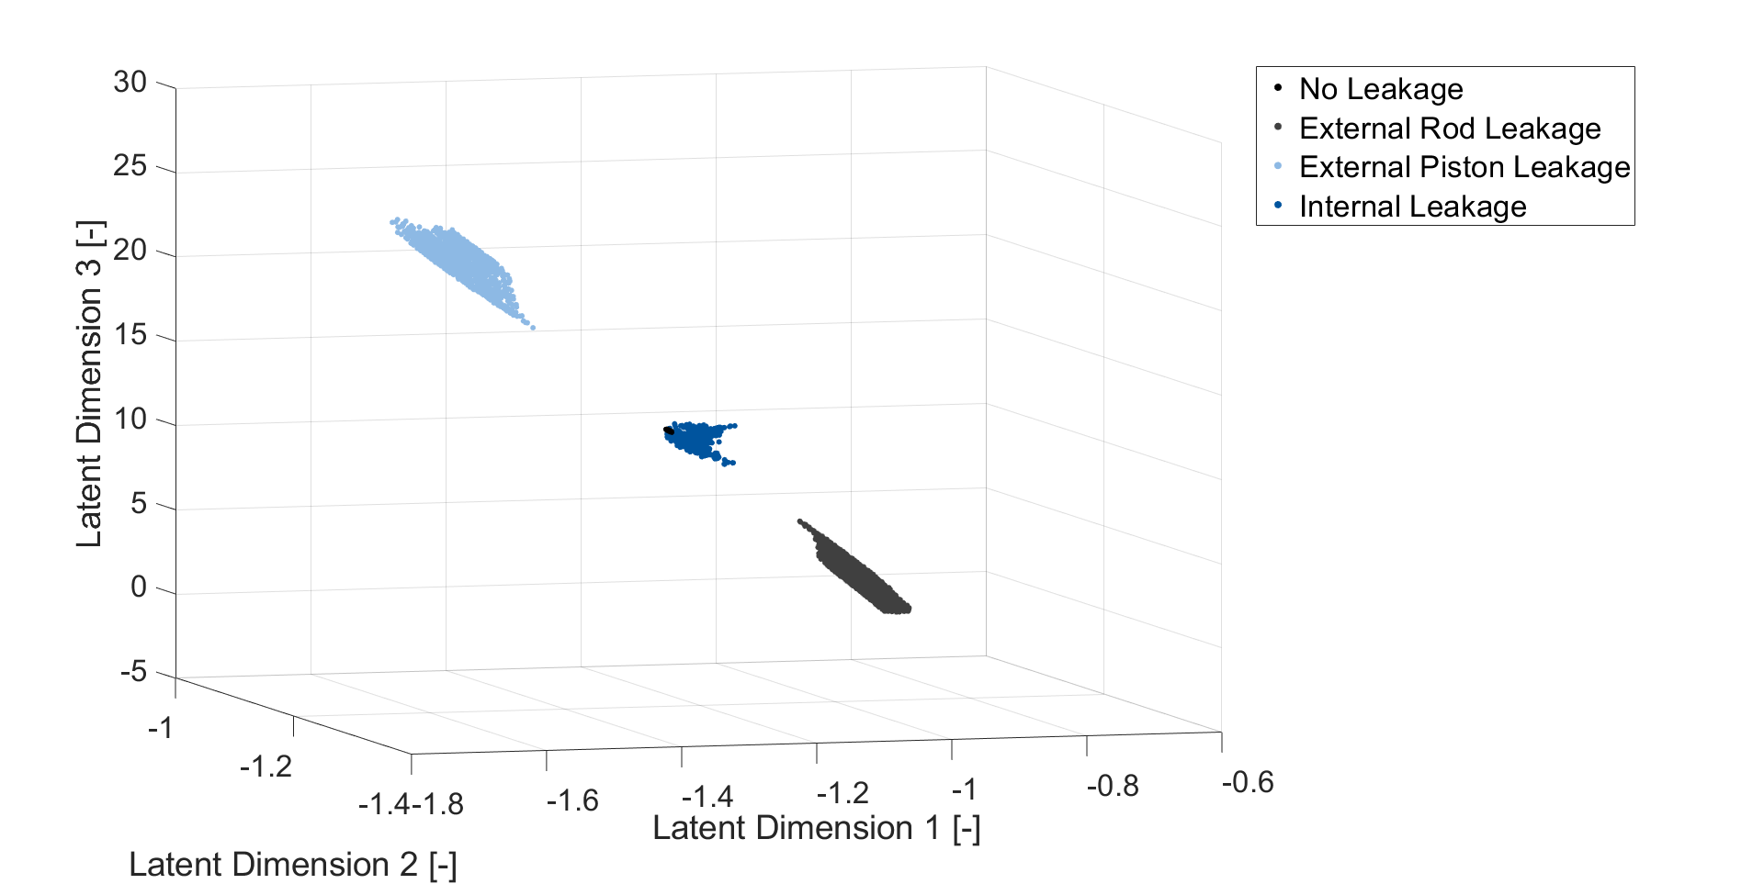
Result
The latent space
generated by
autoencoder model
Linear_F3_L4
Each data point
represent the
mean of
latent values
of a sequence
Notes:
This is the latent space generated by model Linear_F3_L4.

